Slide 1
Advancing Evidence-Based Innovation
Frequently Asked Questions [FAQs] Cohort
Notes:
Welcome to D031 Advancing Evidence-Based Innovation: Frequently Asked Questions Cohort

Slide 2

How do I explore the role of a nurse innovator?
Observation of nurses and other professionals
Review of the literature
Notes:
How do I explore the role of a nurse innovator?
During the process of collaborating with nurses and interprofessional team members in your CoP, you will recognize the
Education,
Experience, and
Skills required to successfully perform this role.
Review the literature for more examples of this role.
Be sure to cite references for your PA task description of the innovative nurse leader role.

Slide 3
What are some characteristics of a nurse innovator?
Welcome constant change
Support continual learning
Promote ongoing experimentation with alternative problem-solving approaches
Encourage thinking that is different from the norm
Notes:
What are some characteristics of a nurse innovator?
Innovative nurse leaders consider changes before adverse events require them.
They also
Welcome constant change
Support continual learning
Promote ongoing experimentation with alternative problem-solving approaches
Encourage thinking that is different from the norm

Slide 4
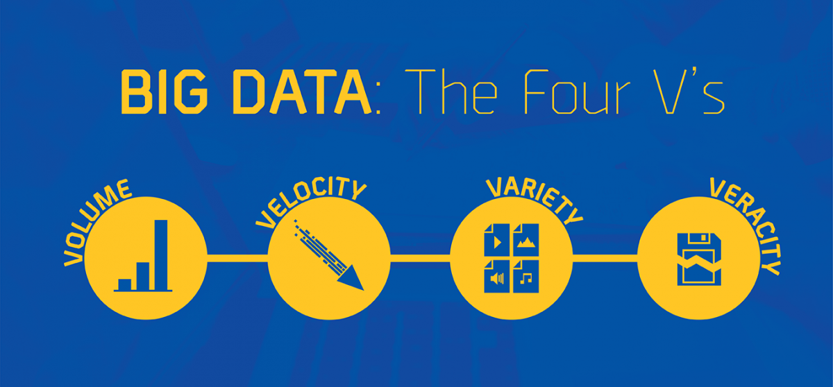
How do you define big data?
A large volume of structured and unstructured data.
Volume, variety of types and the velocity at which data is processed
Used to determine patterns, predict outcomes and make more responsible decisions
Notes:
How do you define big data?
Big data is a massive volume of both structured and unstructured data that is so large, that it is difficult to process using traditional database and software techniques.
Big data also is defined by the Volume of data, variety of types of data and the velocity at which data is processed, all of which combine to make Big Data very difficult to manage.
Big data is used to determine patterns, predict future outcomes and make more responsible decisions.

Slide 5
Do you have any tips for finding articles for the Relevant Sources Review?
The WGU library
Google Scholar https://scholar.google.com
Choose articles that:
*Are easy to understand
*Clearly state type of research under the methods section
Notes:
Do you have any tips for finding articles for the Relevant Sources Review?
The WGU library is a great resource for finding articles
Searching within Google Scholar https://scholar.google.com is also useful, especially if you are starting with a broad topic
Select articles that are easy to understand and clearly state the type of research study under the methods section.
In the developing recommendations section, cite relevant quotations from each article for support.

Slide 6
What is big data and how is it used in healthcare?
Big data - Huge quantities of data too large or complex for traditional technology to make sense of.
Healthcare organizations can consolidate and analyze the data in order to:
Discover trends
Improve treatments
Accurately predict outcomes
Tailored and success-oriented future treatment plans
Notes:
What is big data and how is it used in healthcare?
Big data is described as huge quantities of data too large or complex for traditional technology to make sense of.
Healthcare organizations can consolidate and analyze the data in order to discover trends
better treat patients
and make more accurate predictions
Big data can also be used as a predictive tool to create a more tailored and success-oriented plan for future patient treatments.
By exploring successful treatments and connecting them to outcomes, healthcare professionals can leverage big data to create unique and effective treatment strategies.

Slide 7


How would you describe small data in healthcare?
Small data is:
Meaningful
Organized
Accessible
Understandable
Actionable
Examples of small data include: • Missed clinic appointments • Allergic reactions to drugs • Operating room turnover times • Timeliness of blood cultures for septic patients
Notes:
How would you describe small data in healthcare?
Small data connects people with timely, meaningful insights (derived from Big Data and/or sources), organized, accessible, understandable, and actionable for everyday tasks.
Small data are stored in hospital electronic medical records, paper charts, and pharmacy systems.
Examples of small data include: • Missed clinic appointments • Allergic reactions to drugs • Operating room turnover times • Timeliness of blood cultures for septic patients

Slide 8
How do big data and small data compare?
Big Data
Small Data
What can be the effect of immunization programs?
Where do some of the healthiest people in the world live?
Are there any genetic factors to identify a disease?
Is my child immune to disease?
Is my diabetes medication working as expected?
Am I susceptible to hereditary cancers?
Notes:
How do big data and small data compare?
BIG DATA SMALL DATA
What can be the effect of immunization programs? ----- Is my child immune to disease?
Where do some of the healthiest people in the world live? ----- Is my diabetes medication working as expected?
Are there any genetic factors to identify a disease? ----- Am I susceptible to hereditary cancers?

Slide 9


z
Innovation in healthcare includes changes that help healthcare professionals focus on the patient while working more efficiently.
Notes:
The term disruptive innovation was first coined in the book, The Innovator’s Dilemma. In the 1997 best-seller, Clayton Christensen, a Harvard Business School professor wrote about “why some innovations that were radical in nature reinforced the incumbent’s position in a certain industry, contrary to what previous models would predict.”
Some examples include: an enhanced laptop screen, a faster hard drive processor or superior mobile phone reception.
They can be minor advances or major breakthroughs, but they enable organizations to provide more products to their customers.

Slide 10
What is disruptive innovation?
Disruptive innovation in healthcare:
Views the status quo and envisions a future that is radically different in a positive way
Is NOT a breakthrough innovation that makes good products better
Must transform elements of clinical practice
Notes:
What is disruptive innovation?
Disruptive innovation in healthcare:
Views the status quo and envisions a future that is radically different in a positive way
Is NOT a breakthrough innovation that makes good products better
Must transform elements of clinical practice

Slide 11

Explain disruptive innovation and give some examples?
Affordable
Reliable
Simple
Accessible
Process
Examples:
Lyft, Netflix, iPhone, Retail-based health clinics
Notes:
Explain disruptive innovation and give some examples?
Inability of companies to respond to disruptive innovations in their industries caused them to fail.
Borders – books inability to adapt to new markets when Amazon DISRUPTED THE INDUSTRY and increased online shopping.
Blockbuster was unable to recover when Netflix and streaming services disrupted the entertainment industry
Kodak did not adapt to the disruption of digital media
Disruptive innovations need to be:
Affordable
Reliable
Simple
Accessible
Process
Examples: Lyft, Netflix, iPhone, Retail-based health clinics

Slide 12
Why would I want to leverage the benefits of a disruptive innovation?
Consumers demand convenience and value that empowers them to be healthy
Healthcare organizations must innovative market leaders focused on the consumer experience
Capitalize on benefits and opportunities that will be created
Notes:
Why would I want to leverage the benefits of a disruptive innovation?
Ask yourself, “How can I capitalize on the benefits of this disruptive innovation and the opportunities that will be created?”
Consumers are demanding more convenience and value that empowers them to be healthy.
To remain relevant, generate growth and own their future, healthcare organizations must position themselves as innovative market leaders focused on the consumer experience.

Slide 13

Give an example of leveraging the benefits of a disruptive innovation?[SCENARIO]
Setting: Urgent Care Center
Problem: Increased wait time
Decreased patient satisfaction
Literature review notes virtual queues are a solution
ER wait time = Big Data [can’t connect to actual patient]
Notes:
Give an example of leveraging the benefits of a disruptive innovation?[SCENARIO]
Scenario: A Urgent Care Center notes that notes that the increased wait time to be seen by a provider, exceeds the national benchmark. This is a cause of decreased patient satisfaction.
A literature review revealed that virtual queues increase patient satisfaction. The facility used the BIG DATA of over all ER wait time
The clinic began offering virtual queues, where patients line up ahead of time from their phones or online.
Patients are told how many other people are ahead of them and are given an estimate of when they can see a doctor, saving them from long stretches in the waiting room.
Disruptive innovation often decreases cost and improves quality healthcare outcomes.

Slide 14
What is Roger’s Diffusion of Innovation Theory?
Change model for guiding innovation
Meets needs across all levels of adopters
The theory focuses on communication and peer networking within the adoption process.
For more information, view the D031 recorded cohort on Roger’s Theory
Notes:
What is Roger’s Diffusion of Innovation Theory?
It is a change model for guiding innovation that is presented in ways that meet the needs across all levels of adopters
The theory focuses on the importance of communication and peer networking within the adoption process.
There is a separate D031 recorded cohort that explains this theory in detail.

Slide 15

Do I have to include actual numbers when discussing the financial impact of my innovation?
Actual dollar amounts are not required
Consider the costs for each phase of the implementation
Training
Salaries
Materials
Consider the potential cost savings as a result of the innovation
Notes:
Do I have to include actual numbers when discussing the financial impact of my innovation?
Actual dollar amounts are not required to discuss the financial implications of the innovation. If you have numbers available, you may include them.
Consider the costs for each phase of the implementation such as training, salaries for nurses or other staff involved, materials, etc.
Consider what savings or return on the investment that your facility may receive as a result of the innovation.

Slide 16
What are some initial steps before beginning the D031 PA task?
Is there relevant evidence in the literature related to the innovation?
Can big data be used to support the innovation?
Are there technology enhancements that are required for the innovation?
Is this innovation disruptive?
If you answered no to any of these questions, reach out to your course instructor.
Notes:
What are some initial steps before beginning the PA task
Is there relevant evidence in the literature related to the innovation?
Can big data be used to support the innovation?
Are there technology enhancements that are required for the innovation?
Is this innovation disruptive?
If you answered no to any of these questions, reach out to your course instructor.

Slide 17

CONCLUSION
Notes:
Thank you for your attention. Your course instructors will be glad to assist you with any CPE or PA Task Questions.

